Slide 1

SWARNANDHRA INSTITUTE OF ENGINEERING
& TECHNOLOGY
DEPARTMENT OF ELECTRONICS AND COMMUNICATION ENGINEERING
HEART RATE &SPO2 MONITORING SYSTEM
BACHELOR OF TECHNOLOGY
IN
ELECTRONICS AND COMMUNICATION ENGINEERING
Under the Esteemed Guidance of
Mrs.L.SATISH,M.Tech.
2021-2025
SUBMITTED BY :
K.SRAVANI (21EM1A0464)
K.M DEEPIKA (21EM1A0459)
J. MOUNIKA MANASA (21EM1A0451)
B.L M CHANDRAKALA (21EM1A0420)

Slide 2
TABLE OF CONTENTS
INTRODUCTION
ABSTRACT
LITERATURE SURVEY
EXISTING SYSTEM & LIMITATIONS
PROPOSED SYSTEM
IMPLEMENTATION AND RESULT
CONCLUSION AND FUTURE SCOPES
REFERENCE

Slide 3
INTRODUCTION
  Health Monitoring: Continuous monitoring of vital signs such as heart rate and SpO2 is crucial in healthcare.
  Importance: These parameters play a significant role in diagnosing respiratory and cardiovascular conditions.
  Embedded Systems: The project leverages embedded systems to design a portable, real-time monitoring system.
  Objective: The goal is to create an efficient, cost-effective solution for heart rate and SpO2 tracking that can be used in hospitals or home care settings.

Slide 4
ABSTRACT
This project focuses on the development of a Heart Rate and SpO2 Monitoring System using embedded systems. The system uses a pulse oximeter sensor to measure the heart rate and blood oxygen saturation (SpO2) levels of a person. The data is processed using a microcontroller and displayed on an LCD/OLED screen. The system provides real-time monitoring of vital signs and has potential applications in healthcare, fitness, and emergency services. Additionally, it can be enhanced to offer remote monitoring using wireless communication technologies.

Slide 5
LITERATURE SURVEY
  Existing Methods:
    Most heart rate and SpO2 measurement systems rely on pulse oximeters connected to dedicated medical devices, such as monitors or ECG machines.
    Some wearable devices (smartwatches) offer heart rate and SpO2 monitoring but may not be as accurate or reliable for medical purposes.
  Embedded System Solutions:
    Research suggests that microcontroller-based pulse oximeter systems can provide a cost-effective, portable solution for vital signs monitoring.
  Technological Advancements:
    Integration of sensors like MAX30100/MAX30102 with low-power microcontrollers (e.g., Arduino, ESP32) for accurate and low-cost solutions.
    Wireless communication via Bluetooth or Wifi for remote monitoring.

Slide 6
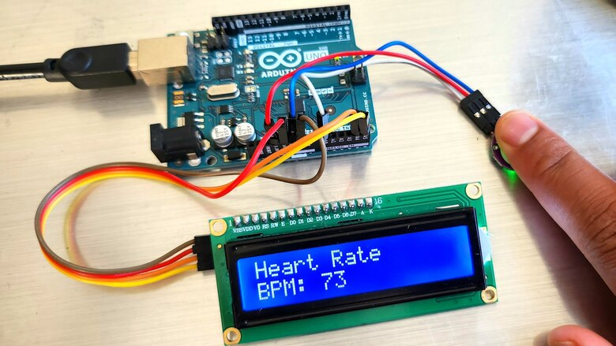
FLOW DIAGRAM :-

Slide 7
EXISTING SYSTEM & LIMITATIONS
Existing System:
Traditional pulse oximeters used in healthcare are typically bulky and expensive.
Clinical devices require constant manual monitoring and may not provide real-time alerts.
Wearable devices (smartwatches) provide basic monitoring but are not always reliable in detecting abnormal readings or medical-grade measurements.
Limitations:
Cost: Medical-grade pulse oximeters can be expensive, limiting accessibility for all users.
Size and Portability: Many existing systems are bulky and not suitable for continuous home monitoring.
Accuracy: Wearable devices may lack the accuracy needed for medical use, especially in low blood oxygen saturation levels.
Real-time Monitoring: Many devices do not provide real-time alerts or the capability to monitor multiple parameters simultaneously.

Slide 8
PROPOSED SYSTEM
  Core Components:
    Pulse Oximeter Sensor (MAX30100/MAX30102): Used for accurate measurement of heart rate and SpO2 levels.
    Microcontroller (Arduino/ESP32): Handles data collection, processing, and communication with the display or wireless module.
    Display: LCD/OLED for real-time visualization of heart rate and SpO2 levels.
    Wireless Module (Bluetooth/Wi-Fi): For optional remote monitoring via mobile or PC.
  Working:
    The sensor detects variations in light absorption, which correspond to heart rate and blood oxygen levels.
    The microcontroller processes the data and displays the results on the screen.
    Alerts or notifications can be sent if abnormal values are detected, ensuring timely intervention.

Slide 9
IMPLEMENTATION AND RESULT
System Implementation:
Circuit Design: The pulse oximeter sensor is connected to the microcontroller, with output routed to the display module.
Software Design: Code written in C or embedded Python to acquire sensor data, process it, and display the results.
Testing: The system was tested with various subjects, and the readings were compared to standard medical devices to ensure accuracy.
Results:
The system successfully displayed accurate heart rate and SpO2 values.
Wireless transmission to a mobile app (if implemented) enabled remote monitoring.
The system proved to be reliable for continuous monitoring in both clinical and home settings.

Slide 10
CONCLUSION AND FUTURE SCOPE
Conclusion:
The Heart Rate & SpO2 Monitoring System is an effective, low-cost solution for continuous monitoring of vital signs.
It offers portability, real-time data, and can be easily integrated into both clinical and personal health monitoring environments.
The system also addresses key limitations of existing medical devices, such as cost and portability.

Slide 11
FUTURE SCOPE
Cloud Integration: Data can be stored and analyzed in the cloud for long-term health monitoring.
Mobile App Integration: Development of a smartphone app to provide real-time notifications and historical data analysis.
Multi-Parameter Monitoring: Integration of additional sensors for monitoring other vital parameters, such as blood pressure or temperature.
Artificial Intelligence: Incorporating machine learning algorithms to predict health trends and notify of potential medical conditions before they occur.

Slide 12
REFERENCE
References:
[1] Author, "Title of Article or Book," Journal Name/Publisher, Year.
[2] Pulse Oximeter Sensor MAX30102 Datasheet.
[3] Author, "Embedded System Design," Publisher, Year.
[4] Other relevant articles, research papers, and online resources

Slide 13
THANK YOU

